Slide 1
Adaptive Engagement of Cognitive Control in Context-Dependent Decision Making
Author: Michael L. Waskom
Reporter: Xiaokai Xia

Slide 2
Introduction
How to making decision with context information

Slide 3
Abstract
Introduction
Decision making require context-dependent information
Brain need reduce the costs of cognitive resource
People can reduce demands by exploiting statistical structure in environment
Method
Using a context-dependent perceptual discrimination task
model-based analyses of behavioral and neuroimaging data

Slide 4
Abstract
Evidence
Behavior : predictions about context facilitated decision making
Neuroimage : prediction error accounted for engagement of the frontoparietal control network
Conclude
decision making is adaptively tuned by experience
Using experience can minimize costs while maintaining flexibility

Slide 5
Introduction
Interaction between Human and Environment
Humans inhabit complex and dynamic environments
selectively attend to features
relevant to our current goals
Two approach
Fixed on all information
Cannot account for the flexibility of decision making¹
Dynamically align sensorimotor transformations with the rules²
These processes are termed cognitive control
Botvinick et al. 2009; Duncan 2013
Cohen et al. 1990; Miller and Cohen 2001; Botvinick and Cohen 2014

Slide 6
Introduction
Neuromechanism of Cognitive Control
Network of regions in lateral prefrontal and parietal association cortex¹
Neurons in this network can response²
High-level stimulus information
Abstract task states
The pattern of the activity across these neurons can encode a representation of the current task context³
Goldman-Rakic 1987; Miller and Cohen 2001; Koechlin et al. 2003, Wagner et al. 2004; Badre 2008; Cole et al. 2013
Buschman et al. 2012; Stokes et al. 2013
Mante et al. 2013; Rigotti et al. 2013

Slide 7
Introduction
Reducing the Cost of Cognitive Control
Humans strategically avoid situations that require control¹
Limited by subject
Disrupted by current demands²
It is unclear how to achieved
Kahneman 1973; Kool et al. 2010; McGuire and Botvinick 2010
Shiffrin and Schneider 1977; Duncan 1980; Marois and Ivanoff 2005

Slide 8
Introduction
Predictive model
Predictive model can facilitated context-dependent behavior
Predictive model abstract representations of task context
Cognitive control is engaged when expectations are violated
How to measure predictive model
Using prediction error to measure violation of expectations
No straightforward algorithm
Using Bayesian ideal observer model to estimate

Slide 9
Introduction
Bayesian Ideal Observer Model¹
Using this model to measure the evolving state of the environment
Timothy Behrens, 2007

Slide 10
Introduction
Result
Experiment
The decision making sensitive to environmental statistics
Context prediction error accounted for engagement of frontoparietal control network
Modeling
Prediction error modulated the distributed representation of task context
( Strongest representation ⬄ largest prediction error )
Both
Accounting how adaptive learning can regulate the engagement of control processes

Slide 11
Methods
Experiment / Model / Analysis

Slide 12
Subjects
21 healthy right-handed members
Excluded
One person with poor color vision
One person with low performance
Three person with fatigue or illness
Included
19-29 years old
8 females
$10/h behavior experiment & $20/h scanning session
Additional monetary bonus based on performance

Slide 13
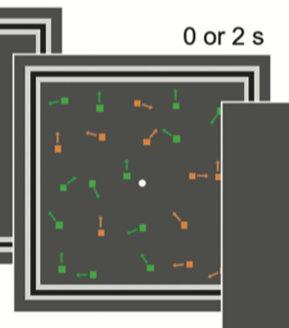
Experiment design
Stimuli
Bivalent random dot stimulus
Color (Red | Green)
Motion (Up | Down | Random)
Maintain fixation on center
Each trial
Motion : Up/down (corresponding to motion value)
Color : Tune to target color (corresponding to color coherence)
Congruent trials held at constant rate

Slide 14

Experiment design
frame
Cue the context for each trial
Four pattern grated by sine-wave
2 to indicating motion trial
2 to indicating color trial
Random pattern across subjects

Slide 15
Experiment design
Task
Motion
Up
Down
Color
Red
Green

Slide 16
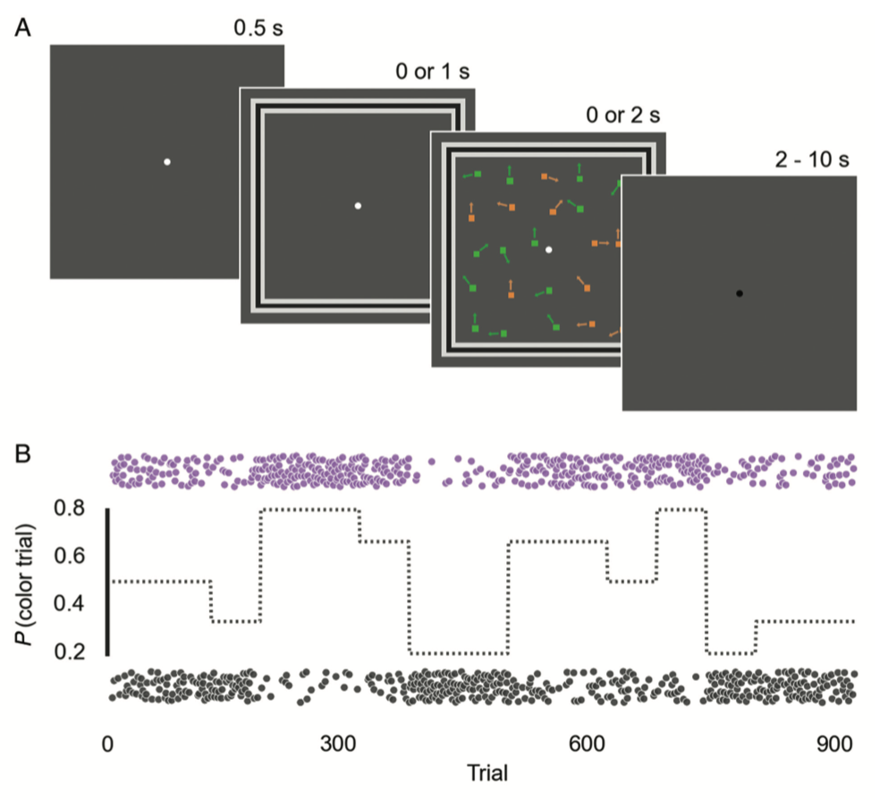
Experiment Design
Procedure

Slide 17
Experiment Design
Procedure
Parameter
900 trials
12 runs
Rapid event-related design
Three type trials ( balanced )
Early-cue: Frame appeared 1s before stimulus
Concurrent-cue: Those appeared at same time
Cue-only: Just frame without dots
Fixation point turn color before onset to alert the subjects
Random Interval ( p = 1/3 , 2 – 10 s, mean = 4 )

Slide 18
Experiment Design
Procedure
Divided into 10 epochs
1/5, 1/3, 1/2, 2/3, 4/5 color trials and complementary proportion of motion trials
Long (120 trials) and short (60 trials) epochs
Ordered 2 epochs for each condition occurred in different halves

Slide 19
Experiment Design
Experiment execution
Phase of training ( 1-3 days before scanned )
Learn: full coherent stimuli in 8 block with feedback
Staircase: 1 – up – 4- down rule
Practice: 200 trials in one block
Scan
Practice trials outside (minimum 150 trials)
Scan stage (120 min)

Slide 20
Model
Simulation model

Slide 21
Model
Simulation model
Described by Behrens¹
Try to predict motion or color trial probabilities
Bayes model
Reinforcement learning
Behrens TEJ, Woolrich MW, Walton ME, Rushworth MFS. 2007. Learning the value of information in an uncertain world. Nat Neurosci. 10:1214–1221.

Slide 22
Model
Simulation model
Described by Behrens¹
Try to predict motion or color trial probabilities
Bayes model
Reinforcement learning
Less Free parameters
Behrens TEJ, Woolrich MW, Walton ME, Rushworth MFS. 2007. Learning the value of information in an uncertain world. Nat Neurosci. 10:1214–1221.

Slide 23
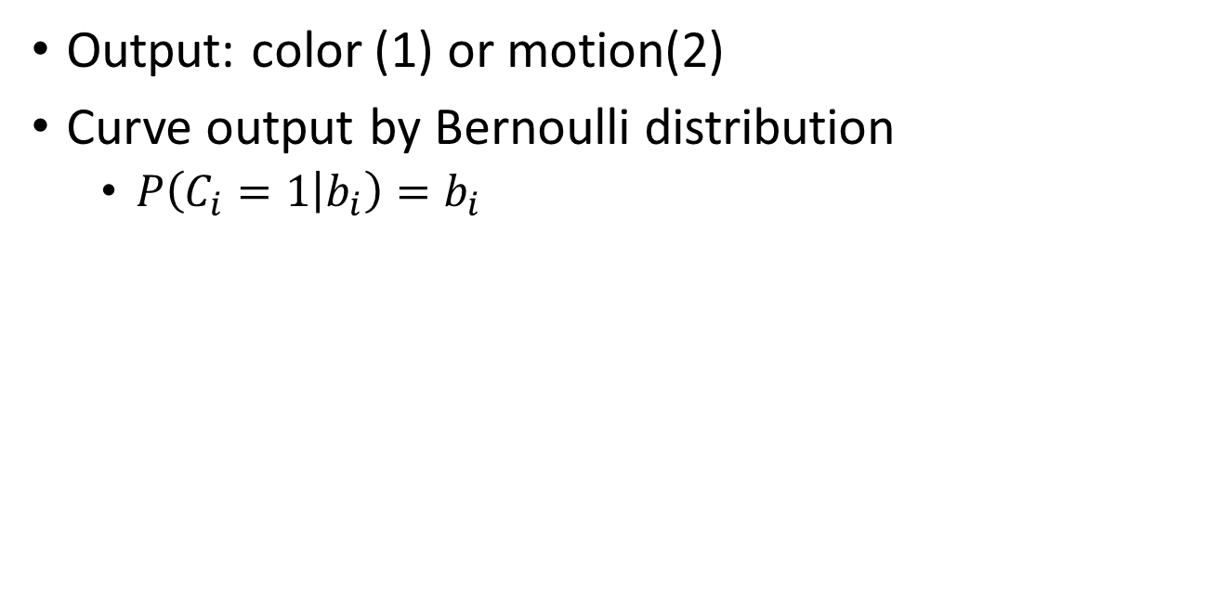
Model
Construct Bayes Ideal Observer Model
Output: color (1) or motion(2)
Curve output by Bernoulli distribution
$P\left(C_{i}=1 | b_{i}\right)=b_{i}$

Slide 24
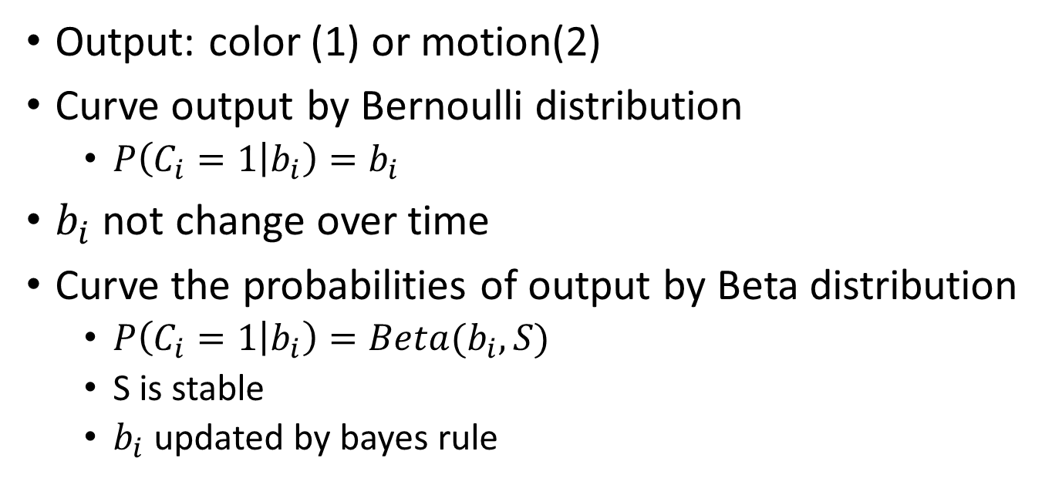
Model
Construct Bayes Ideal Observer Model
Output: color (1) or motion(2)
Curve output by Bernoulli distribution
$P\left(C_{i}=1 | b_{i}\right)=b_{i}$
$b_{i}$ not change over time
Curve the probabilities of output by Beta distribution
$P\left(C_{i}=1 | b_{i}\right)={Beta(b}_{i},S)$
S is stable
$b_{i}$ updated by bayes rule

Slide 25
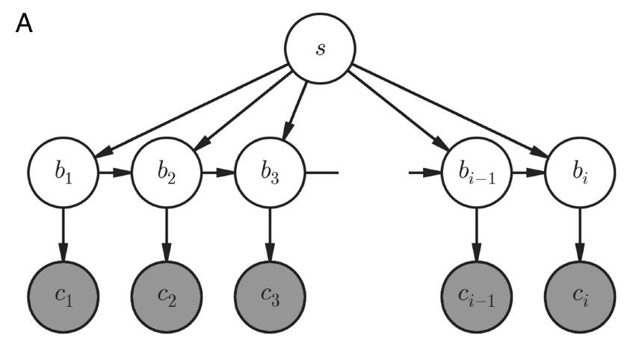
Model
Construct Bayes Ideal Observer Model

Slide 26
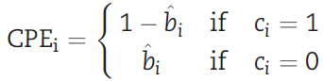
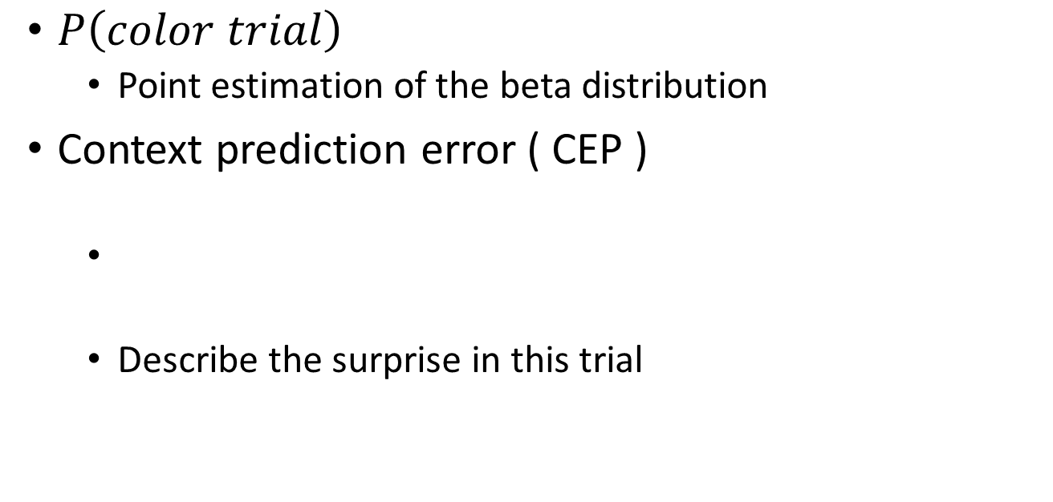
Model
Output from Bayes Ideal Observer Model
$P\left(color trial\right)$
Point estimation of the beta distribution
Context prediction error ( CEP )
Describe the surprise in this trial

Slide 27
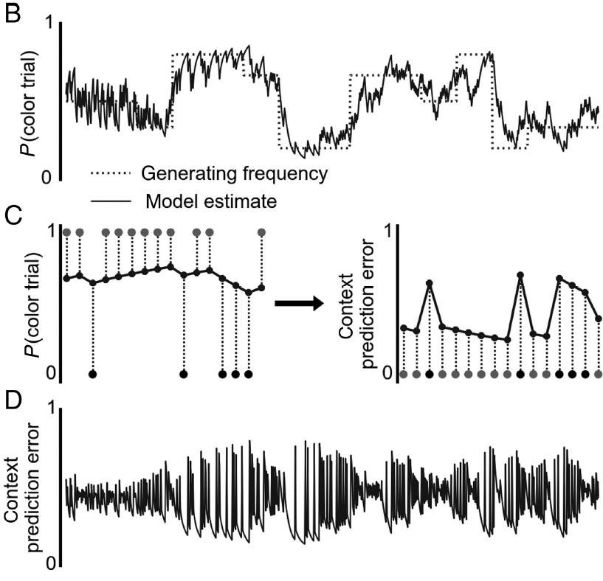
Model
Output from Bayes Ideal Observer Model

Slide 28
Model
Output from Bayes Ideal Observer Model

Slide 29
Model
Output from Bayes Ideal Observer Model

Slide 30
Model
Output from Bayes Ideal Observer Model

Slide 31
Data Analysis
Tools
R & Python
fMRI : FSL, FreeSurfer, ANTs
Behavioral data : lme4
Model
fMRI : GLM, likelihood ratio tests, Dimension Reduction
Behavior data : Mixed-effect Model

Slide 32
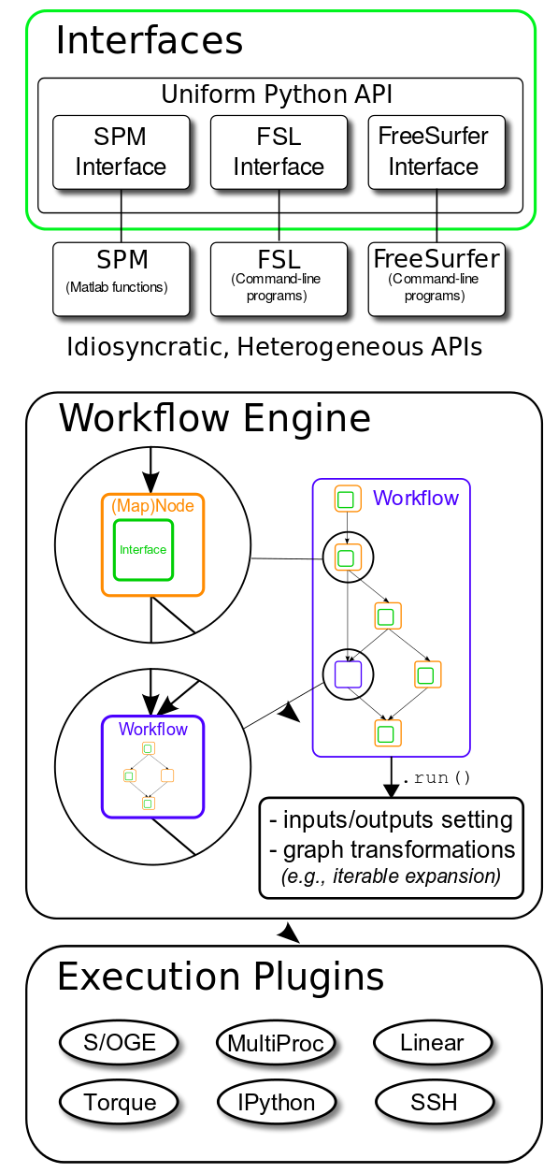
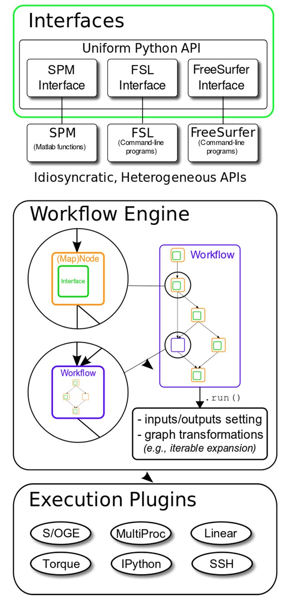
Data Analysis
Nipype

Slide 33
Data Analysis
General Linear Model ( GLM )

Slide 34
Data Analysis
General Linear Model ( GLM )
Regressors
Task events for all trials
Task events
Extract the switch trials
Split into cues period and stimulus period
task events for error trials
RT
CPE
Interaction between RT and error
Interaction between CPE and error

Slide 35
Data Analysis
Mixed-effect Model

Slide 36
Result
Behavior & fMRI (Whole, ROI, Dim Reduction)

Slide 37
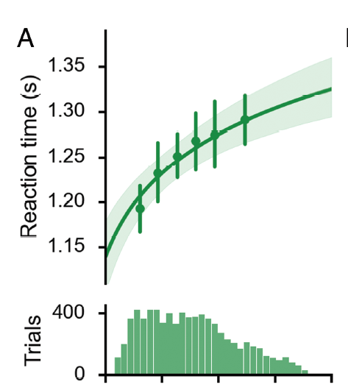
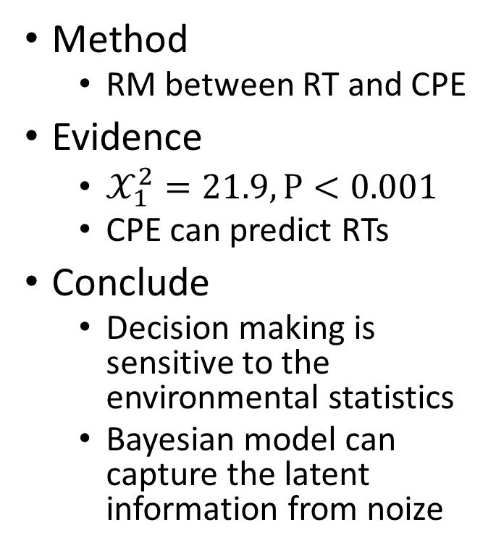
Result of Behavioral Data
Q1: Whether the expectations about context can help decision making
Method
RM between RT and CPE
Evidence
$𝒳_{1}^{2}=21.9, P<0.001$
CPE can predict RTs
Conclude
Decision making is sensitive to the environmental statistics
Bayesian model can capture the latent information from noize

Slide 38
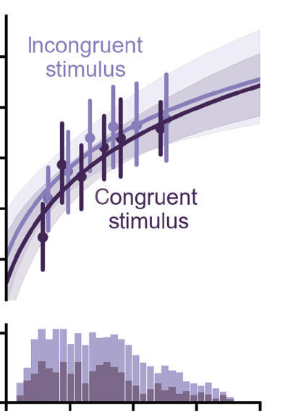
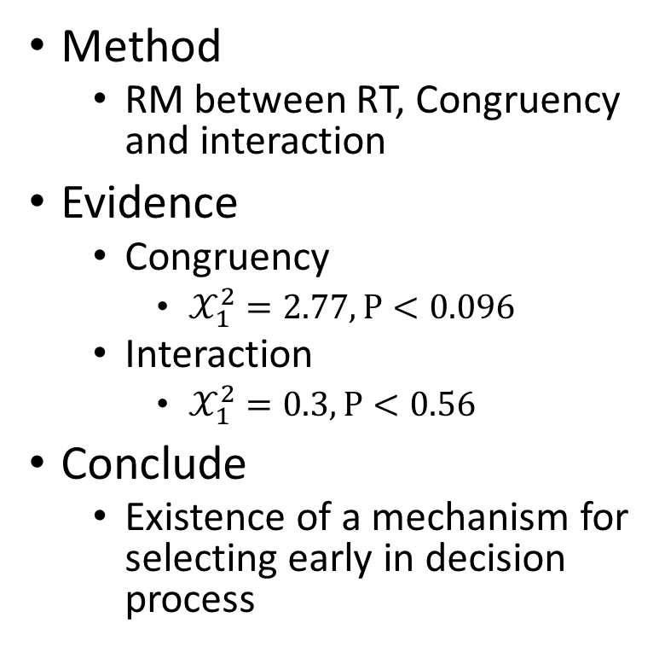
Result of Behavioral Data
Q2: Whether congruency will influence decision making
Method
RM between RT, Congruency and interaction
Evidence
Congruency
$𝒳_{1}^{2}=2.77, P<0.096$
Interaction
$𝒳_{1}^{2}=0.3, P<0.56$
Conclude
Existence of a mechanism for selecting early in decision process

Slide 39
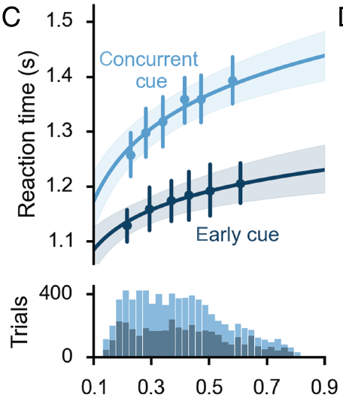
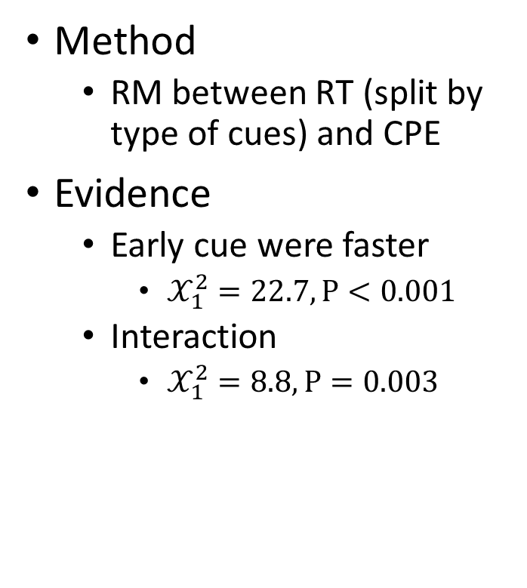
Result of Behavioral Data
Q3: Whether CPE influenced early dimension selection mechanism
Method
RM between RT (split by type of cues) and CPE
Evidence
Early cue were faster
$𝒳_{1}^{2}=22.7, P<0.001$
Interaction
$𝒳_{1}^{2}=8.8, P=0.003$

Slide 40
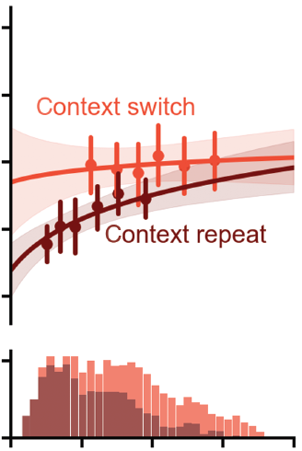
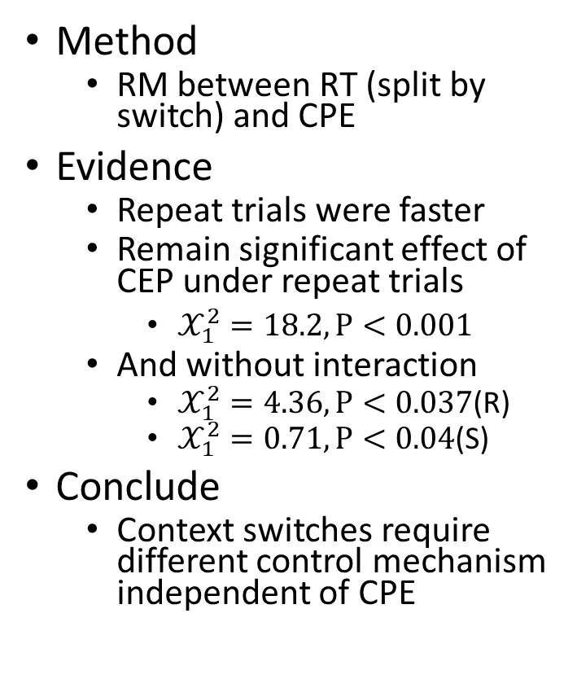
Result of Behavioral Data
Q4: The influence of context changes to RT
Method
RM between RT (split by switch) and CPE
Evidence
Repeat trials were faster
Remain significant effect of CEP under repeat trials
$𝒳_{1}^{2}=18.2, P<0.001$
And without interaction
$𝒳_{1}^{2}=4.36, P<0.037$(R)
$𝒳_{1}^{2}=0.71, P<0.04$(S)
Conclude
Context switches require different control mechanism independent of CPE

Slide 41
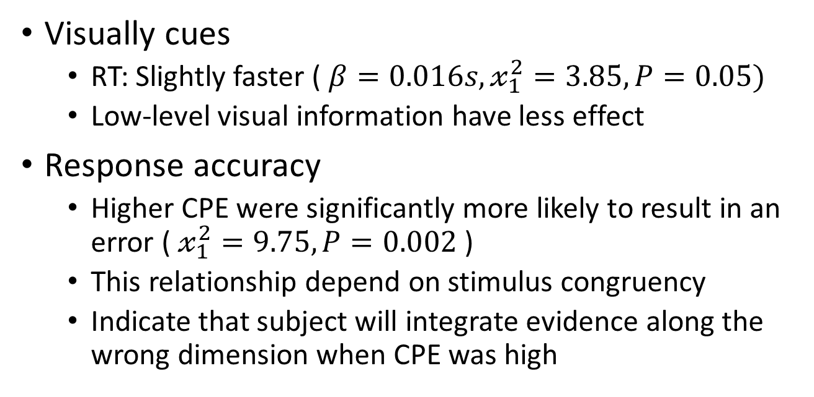
Result of Behavioral Data
Other data
Visually cues
RT: Slightly faster ( $β=0.016s, 𝓍_{1}^{2}=3.85, P=0.05)$
Low-level visual information have less effect
Response accuracy
Higher CPE were significantly more likely to result in an error ( $𝓍_{1}^{2}=9.75, P=0.002$ )
This relationship depend on stimulus congruency
Indicate that subject will integrate evidence along the wrong dimension when CPE was high

Slide 42
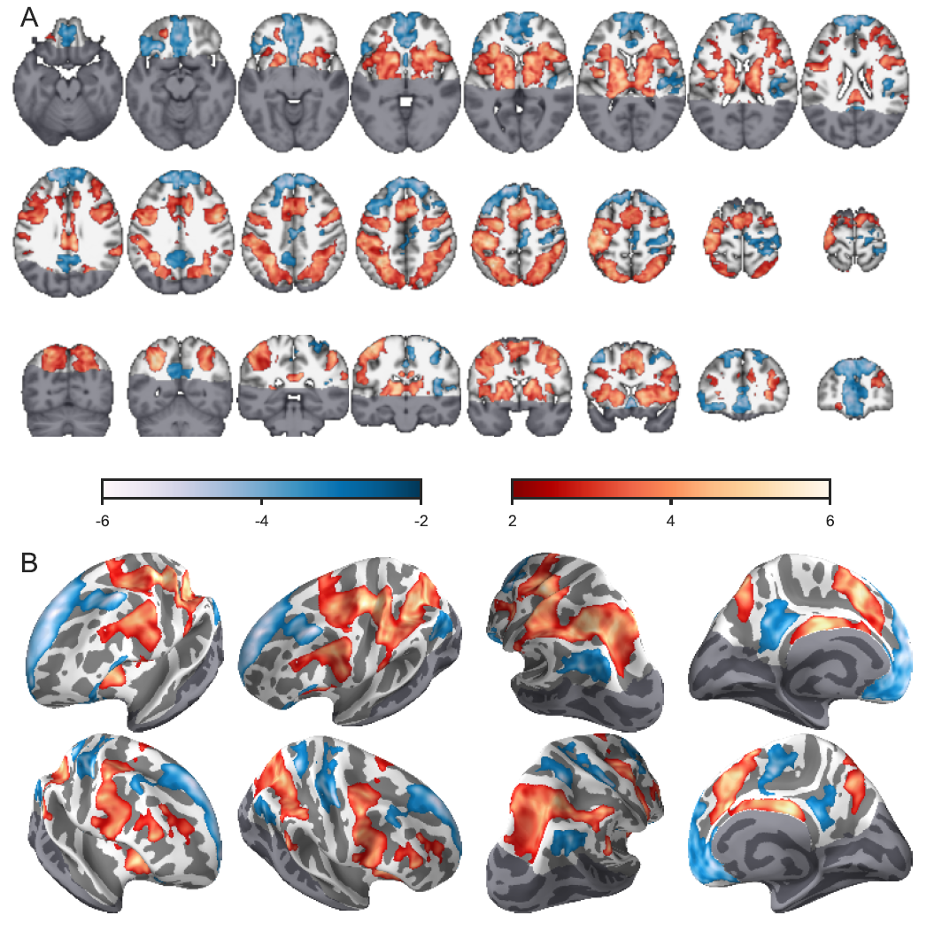
fMRI Analysis
Whole brain Analysis
Task-evoked increases
Cortical dorsal attention network
Frontoparietal network
Cingulo-opercular network
Premotor and motor regions
Basal ganglia and thalamus
Task-evoked decrees
Cortical default network
Explanation
Cognitive Control
Notes:
Task-evoked increases
背侧皮层attention
额顶叶
扣带岛盖网络
Premotor and motor regions
基底核和丘脑
Task-evoked decrees
默认网络

Slide 43
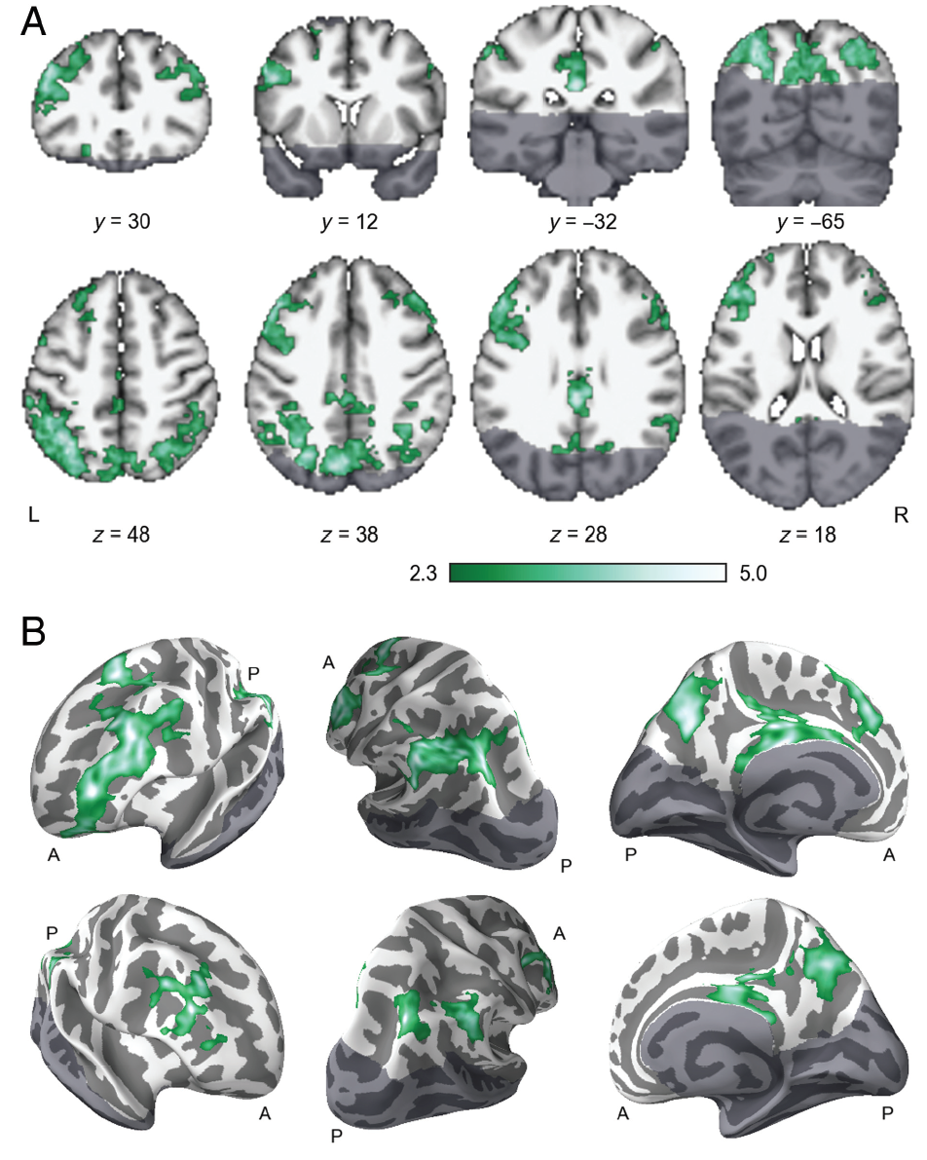
Area scaled by CPE
Inferior frontal sulcus (IFS)
Intraparietal sulcus (IPS)
Medially in the posterior cingulate cortex (PCC)
Superior parietal lobule (mSPL)
Notes:
下额叶沟（视觉感受野）、颅内沟（计划功能）、后扣带回、顶上小叶

Slide 44
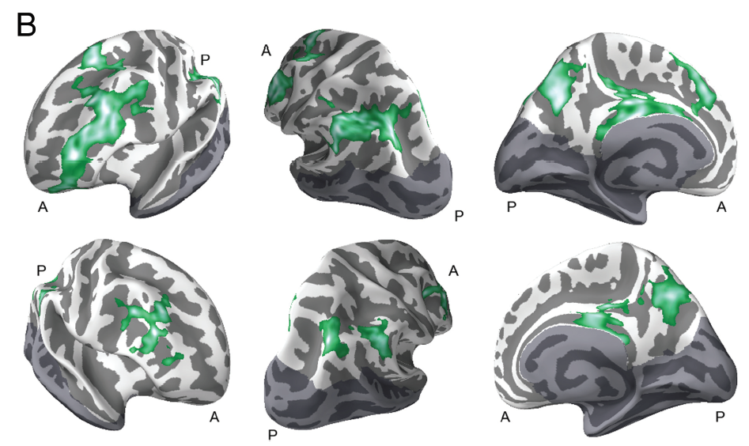
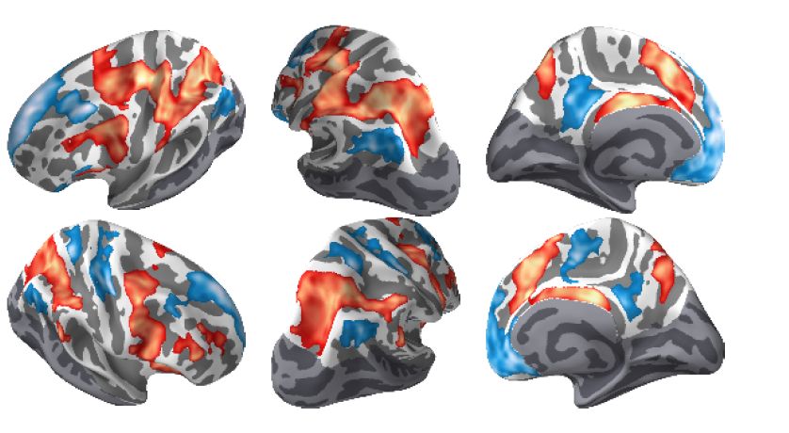
There are some regions did not exhibit task-evoked response

Slide 45
fMRI Analysis
Area scaled by CPE
Includes regions that did not exhibit a strong task-evoked response
No negative relationship with CPE
CPE effect cannot explained by context switching
Notes:
下额叶沟（视觉感受野）、颅内沟（计划功能）、后扣带回、顶上小叶

Slide 46
fMRI Analysis
Area scaled by CPE
Includes regions that did not exhibit a strong task-evoked response
No negative relationship with CPE
CPE effect cannot explained by context switching
Independent neuromechanism
Notes:
下额叶沟（视觉感受野）、颅内沟（计划功能）、后扣带回、顶上小叶

Slide 47
fMRI Analysis
ROI Analysis
Selecting IFS and IPS (previous research¹ ) as prior
Showing the strong effect in model across voxels
IFS: t = 6.16, p < 0.001
IPS: t = 5.93, p < 0.001
mSPL: t = 5.47, p < 0.001
PCC: t = 5.29, p < 0.001
Waskom ML, Kumaran D, Gordon AM, Rissman J, Wagner AD.2014. Frontoparietal representations of task context support the flexible control of goal-directed cognition. J Neurosci. 34:10743–10755.

Slide 48
fMRI Analysis
ROI Analysis
Binned the CPE values by quartiles
Analysis with
Timeseries
Signal change
Split periods

Slide 49
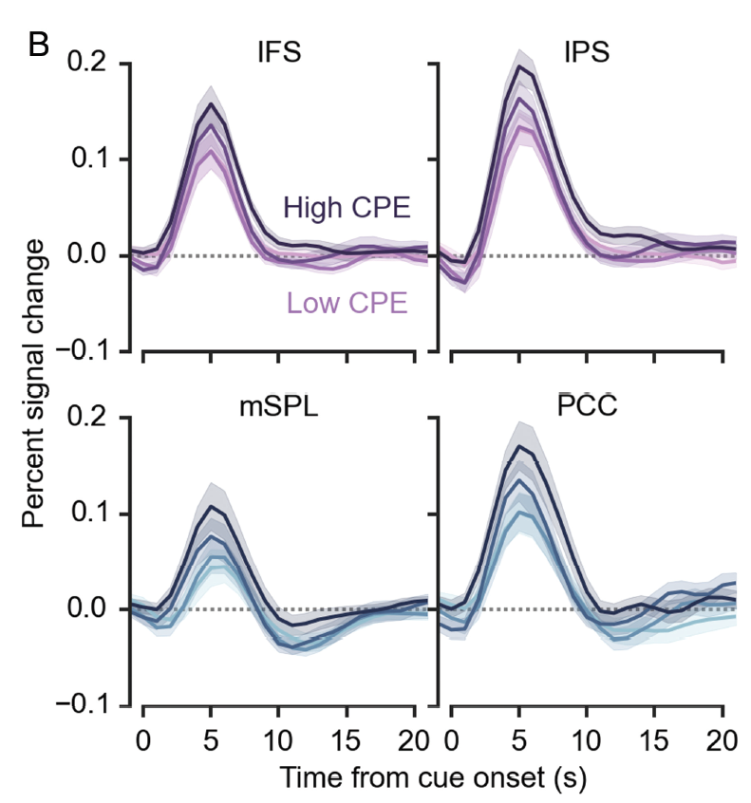
fMRI Analysis
ROI Analysis

Slide 50
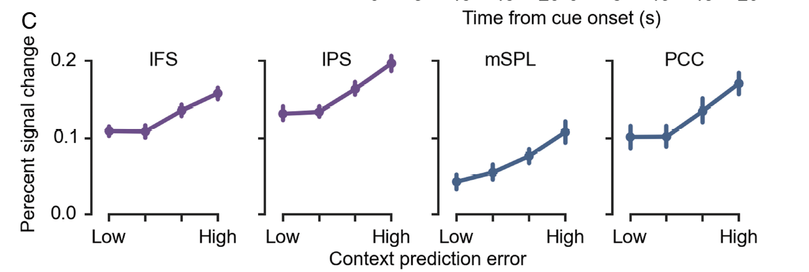
fMRI Analysis
ROI Analysis

Slide 51
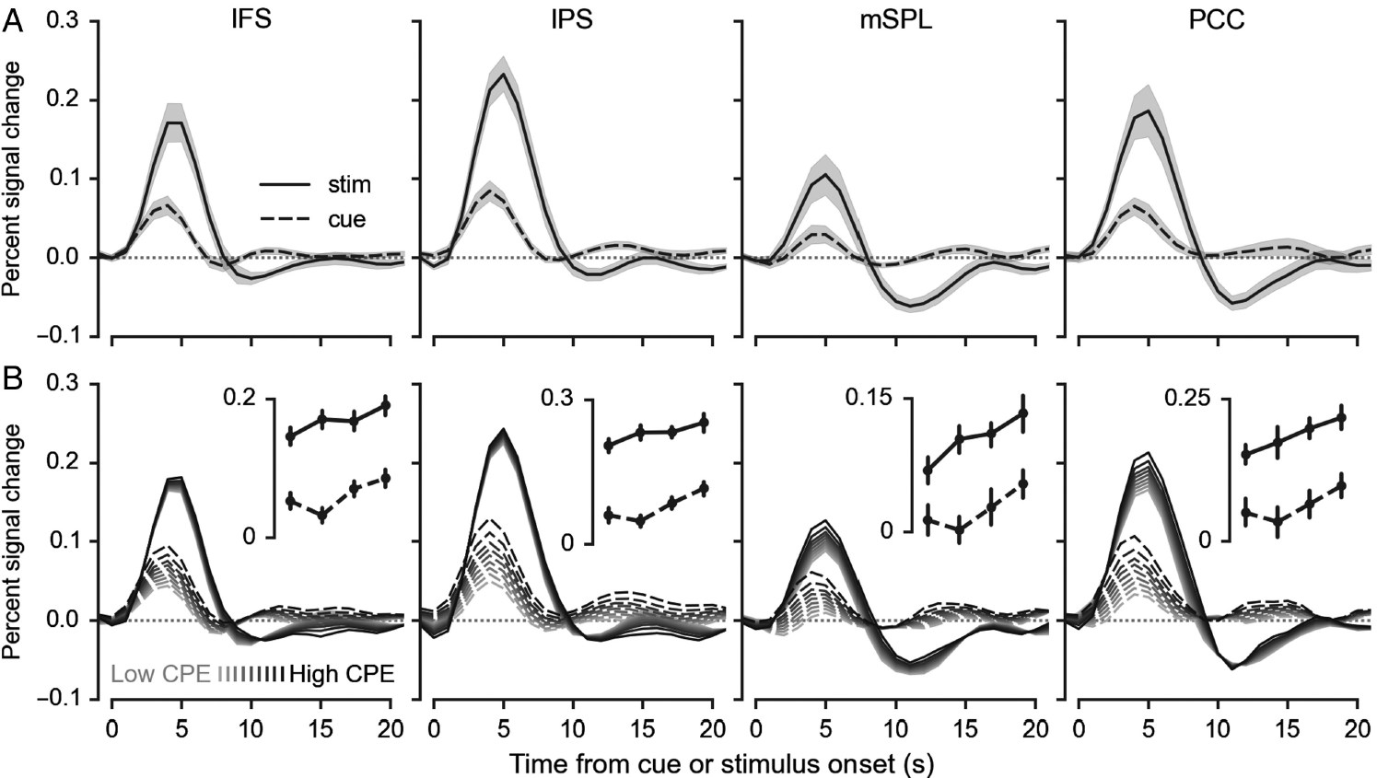
fMRI Analysis
ROI Analysis

Slide 52
fMRI Analysis
ROI Analysis
Conclusion
Those neural effect have high coherence with CEP distribution
Selection of relevant stimulus-response transformations in absence of decision evidence

Slide 53
fMRI Analysis
Dimension Reduction
Goal
Measuring the strength of the context representation
Value
Vectors from odd and even scanning runs
Output
Context tuning during task event after removing effect RT and errors
Result
Between IFS and IPS ( r = 0.81 )
IFS ( mean r = 0.4)
IPS ( mean r = 0.46)
Conclude
IFS and IPS related to abstract context information
Not just visual patterns use cue

Slide 54
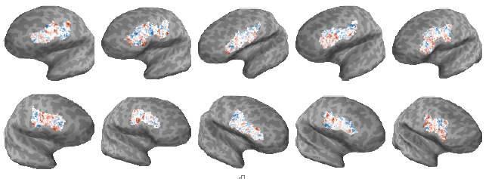
fMRI Analysis
Dimension Reduction
Cluster result

Slide 55
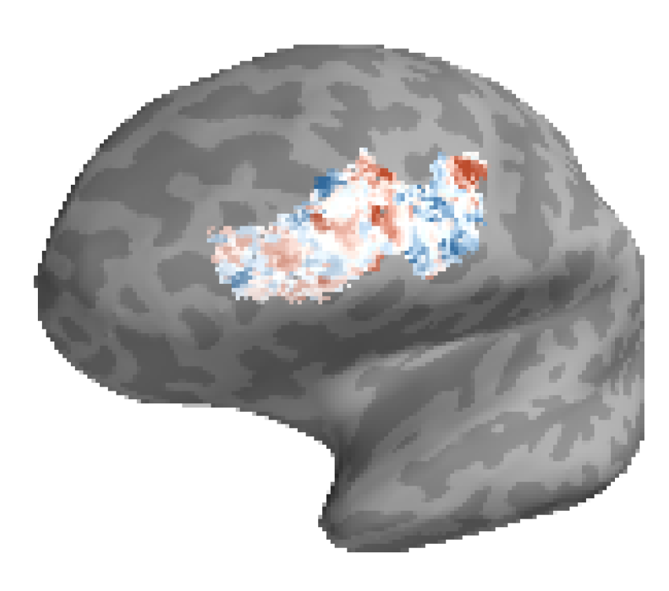
fMRI Analysis
Dimension Reduction
Cluster result

Slide 56
Discussion
Extend the understanding of the Neuromechanism that implement simple decision making
Control appeared at early selection stage
CEP effects on neural signals were strongest when context was unexpected
Frontoparietal control network, including IFS and IPS, is a function of expectations about context
PCC and mSPL may emerge as a coherent network
Model
Before experience have multiple effects on this trial
Unknows
How different neural systems interact to shape expectation about task context

Slide 57
The Glittering of this paper
Robust! Robust! Robust!

Slide 58
The Glittering of this paper
Robust experiment design
Multiple factors without load
Strict performance
Robust Method
Statistic method Likelihood ratio test for main effect
Robust Analysis
Control Variable
Step by step

